Slide 1
Two Sum
Yan Z. Ding
Adopted by and Slightly edited by Wei Jin

Slide 2
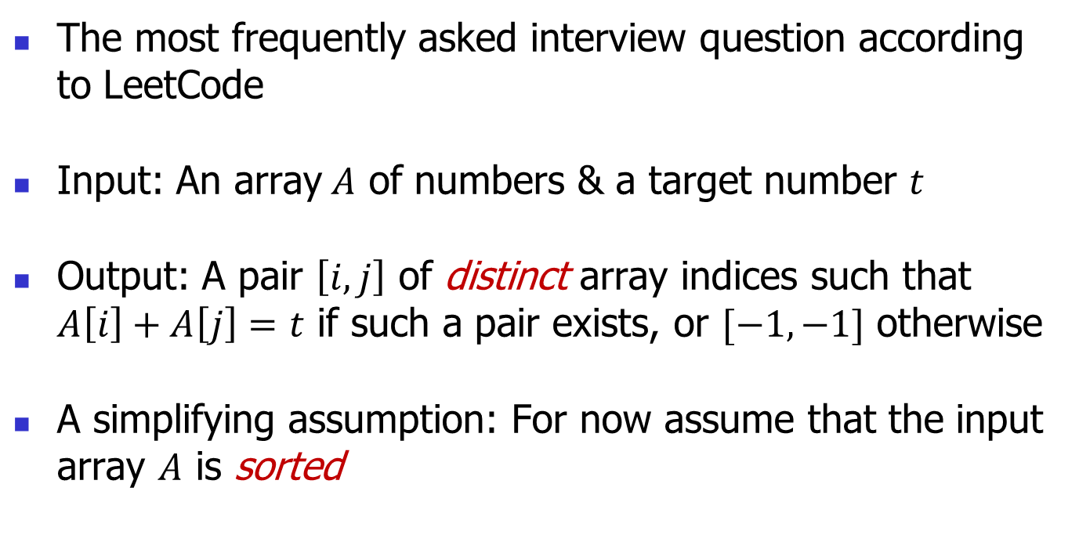
Two Sum
The most frequently asked interview question according to LeetCode
Input: An array$A$ of numbers & a target number $t$
Output: A pair $\left[i,j\right]$ of distinct array indices such that $A\left[i\right]+A\left[j\right]=t$ if such a pair exists, or $[−1,−1]$ otherwise
A simplifying assumption: For now assume that the input array $A$ is sorted

Slide 3
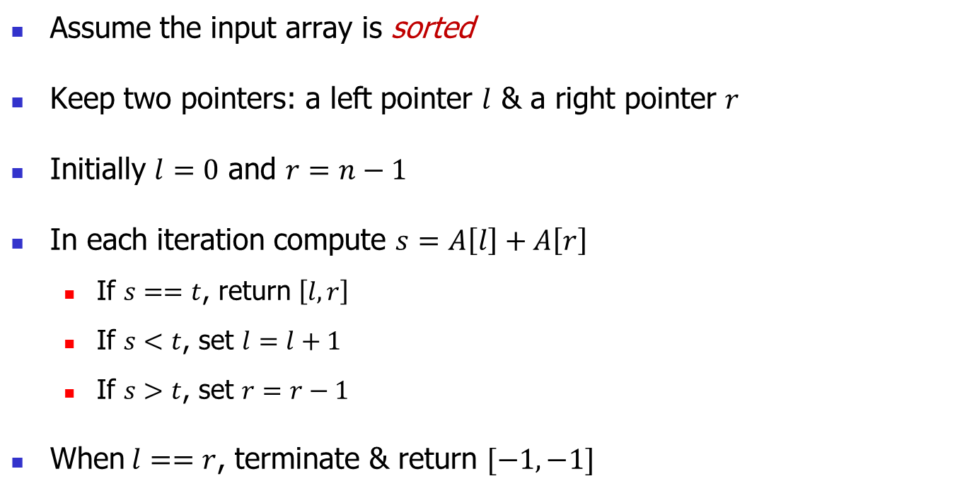
Two Sum Solution – Two Pointers
(Only find one pair)
Assume the input array is sorted
Keep two pointers: a left pointer $l$ & a right pointer $r$
Initially $l=0$ and $r=n−1$
In each iteration compute $s=A\left[l\right]+A\left[r\right]$
  If $s==t$, return $\left[l,r\right]$
  If $s<t$, set $l=l+1$
  If $s>t$, set $r=r−1$
When$l==r$, terminate & return $[−1,−1]$

Slide 4
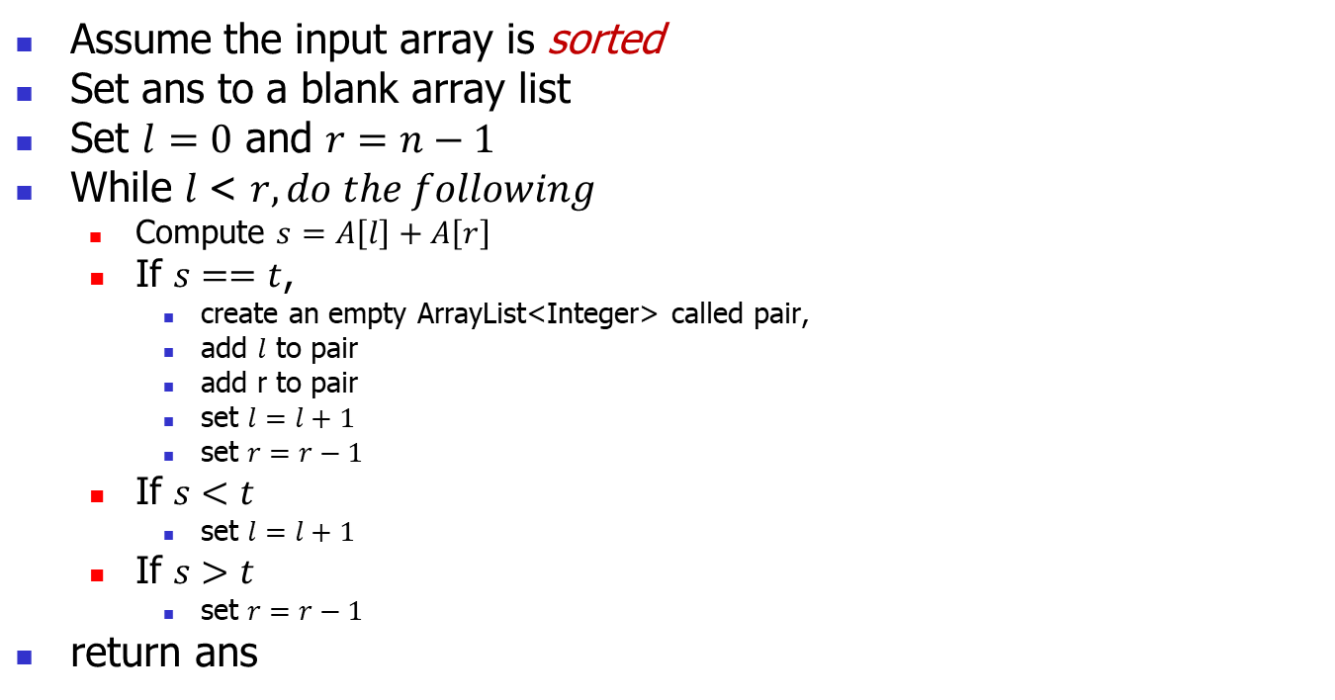
Two Sum Solution – Two Pointers (find all the pairs)
Assume the input array is sorted
Set ans to a blank array list
Set $l=0$ and $r=n−1$
While $l$< $r, do the following$
  Compute $s=A\left[l\right]+A\left[r\right]$
  If $s==t$,
    create an empty ArrayList<Integer> called pair,
    add $l$ to pair
    add r to pair
    set $l=l+1$
    set $r=r−1$
  If $s<t$
    set $l=l+1$
  If $s>t$
    set $r=r−1$
return ans

Slide 5
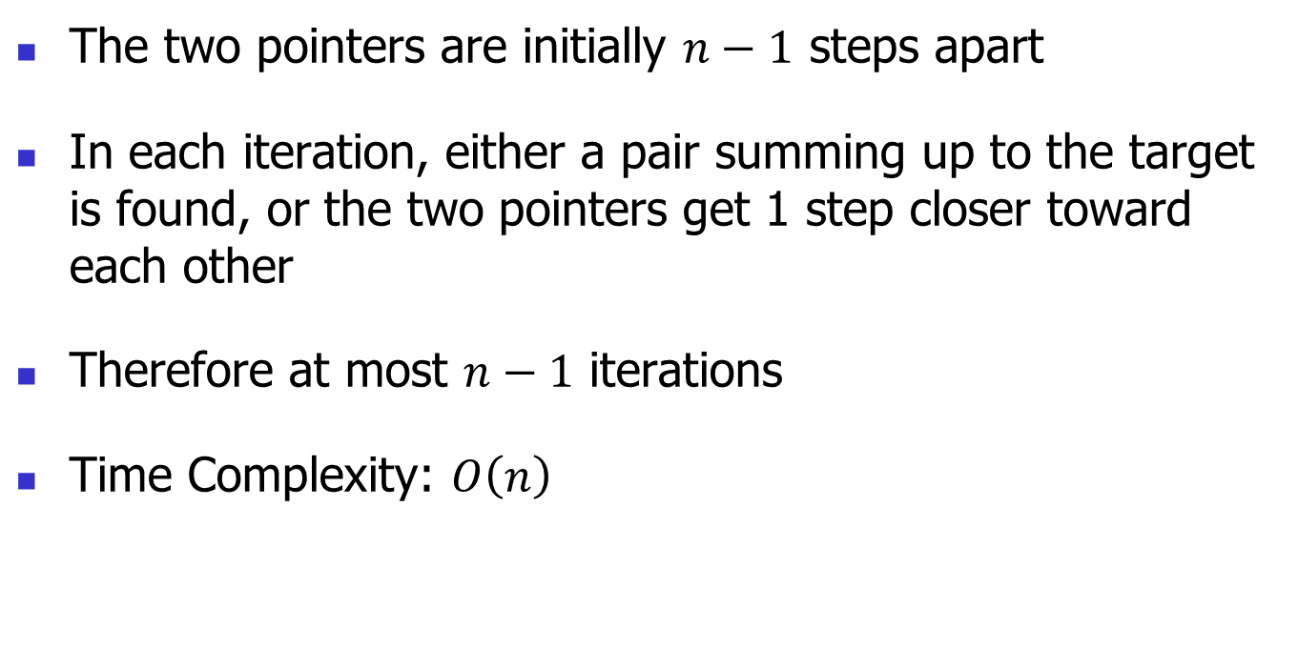
Two Sum Solution – Two Pointers
The two pointers are initially $n−1$ steps apart
In each iteration, either a pair summing up to the target is found, or the two pointers get 1 step closer toward each other
Therefore at most $n−1$ iterations
Time Complexity: $O\left(n\right)$

Slide 6
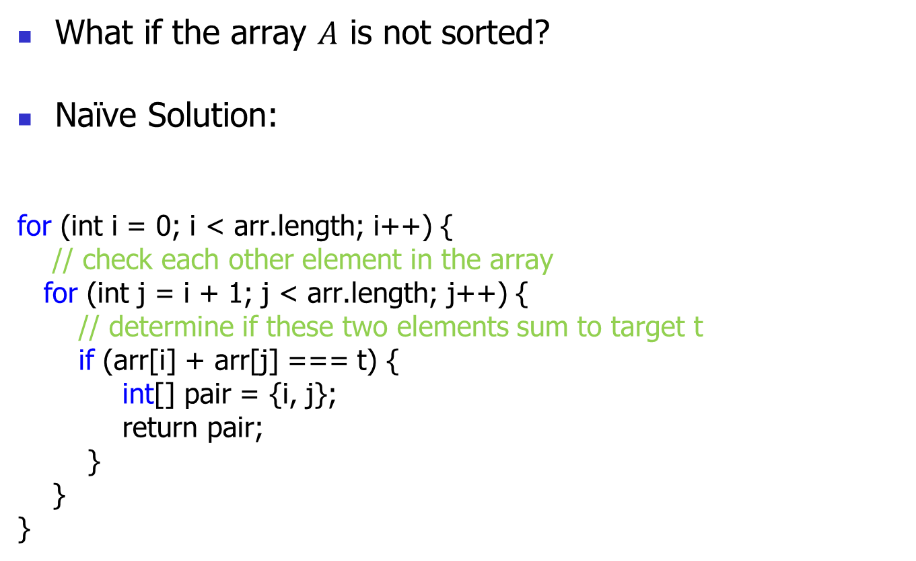
Two Sum
What if the array $A$ is not sorted?
Naïve Solution:
for (int i = 0; i < arr.length; i++) {
// check each other element in the array
for (int j = i + 1; j < arr.length; j++) {
// determine if these two elements sum to target t
if (arr[i] + arr[j] === t) {
int[] pair = {i, j};
return pair;
}
}
}

Slide 7
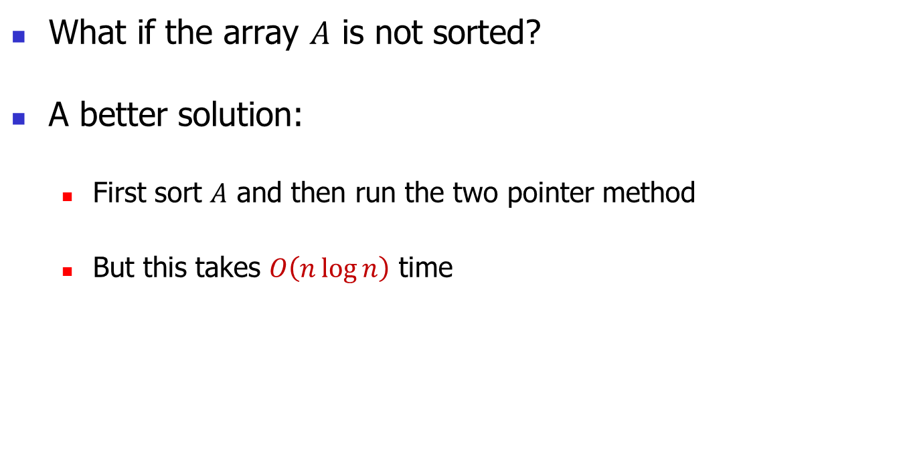
Two Sum
What if the array $A$ is not sorted?
A better solution:
  First sort $A$ and then run the two pointer method
  But this takes $O\left(n\log{n}\right)$ time

Slide 8
Two Sum
A common interview problem - worth studying
https://coderbyte.com/algorithm/two-sum-problem
O(n) solution to Two Sum Problem (see next slide)

Slide 9
Two Sum
O(n) solution: the algorithm makes use of hash tables (hash map) which have a constant lookup time.
Algorithm:
  For each element arr[i] in the array,
    Calculate the complete of arr[i]: c = t – arr[i]
    If c exists in the hash map as a key (that means arr[i] and c are a pair)
      Add the pair (c’s value, i) to the solution.
    If c does not exists in the hash table
      Add the pair (arr[i], i) to hash map.
  Return solution

Slide 10
Two Sum
Since each lookup and insertion in a hash table is O(1) and we only need to loop through the array once, resulting in a running time of O(n)

